Slide 1
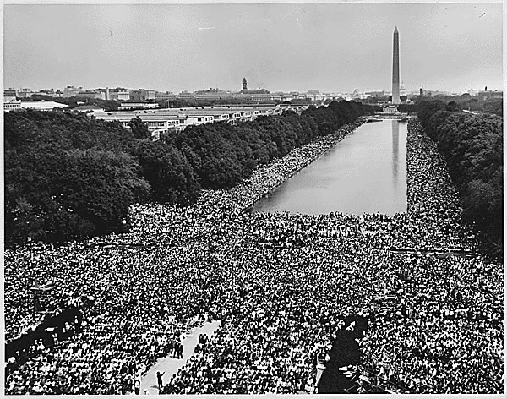
Grassroots information management
Notes:
http://www.flickr.com/photos/usnationalarchives/

Slide 2
Haiti: January 2010
A team of more than 1,000 people formed to translate, annotate, geolocate and categorize reports after the earthquake.
Notes:
The reports are heartbreaking.

Slide 3
4,500 SMS reports mapped from
among approximately 50,000 total.

Slide 4
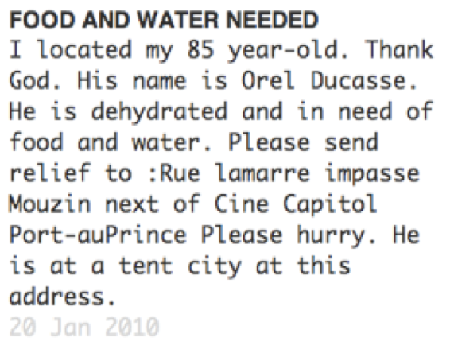
Notes:
The reports are heartbreaking.

Slide 5
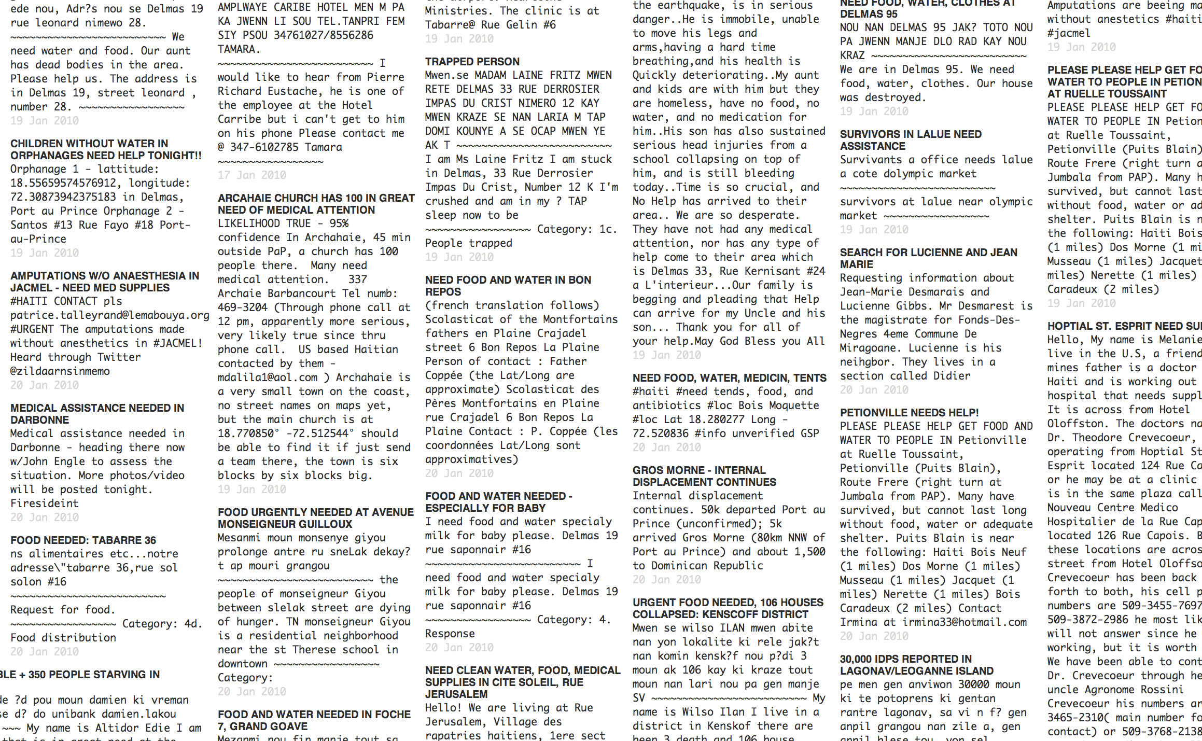

Slide 6
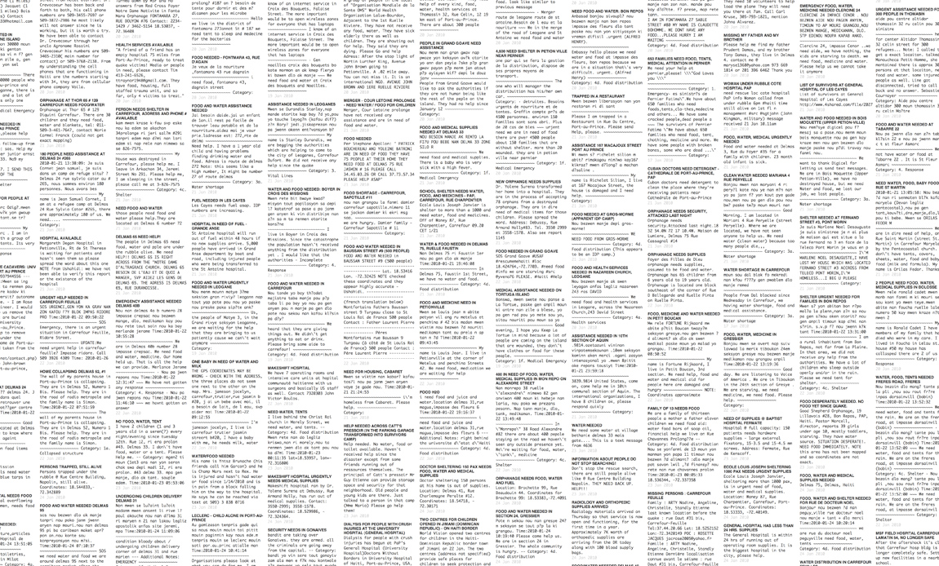

Slide 7


Slide 8
Community translation, annotation,
geolocation, verification, categorization

Slide 9
Why did this work as well as it did?

Slide 10
Why did it work at all?

Slide 11
What can we learn from it?

Slide 12
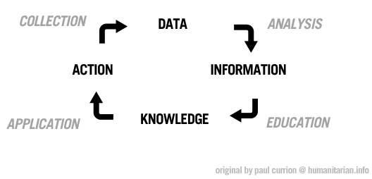
Information management is an opportunity.
Notes:
This is a standard diagram of information management.

Slide 13
How do we improve participation in information management?

Slide 14
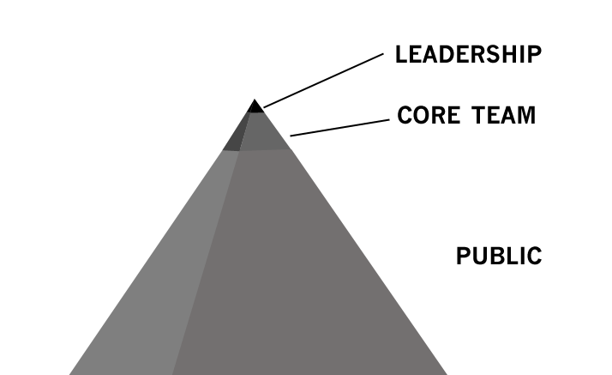
One view of “crowdsourcing”
Notes:
For a long time over the last two years I have drawn this pyramid. Many of us dream of a broader base of participatory media.

Slide 15
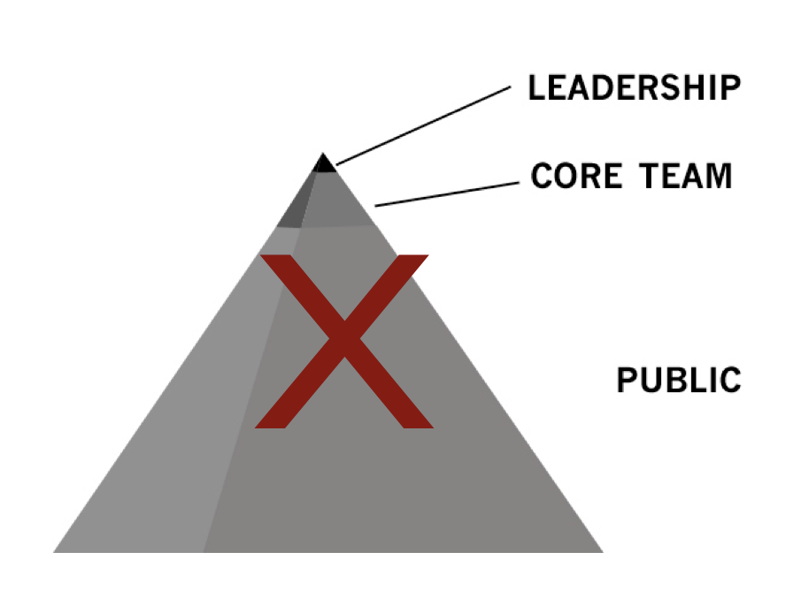
We put ourselves on a pedestal.
Notes:
But after a while I realized how hierarchical it is – and that doesn’t match my experience on these projects at all.

Slide 16
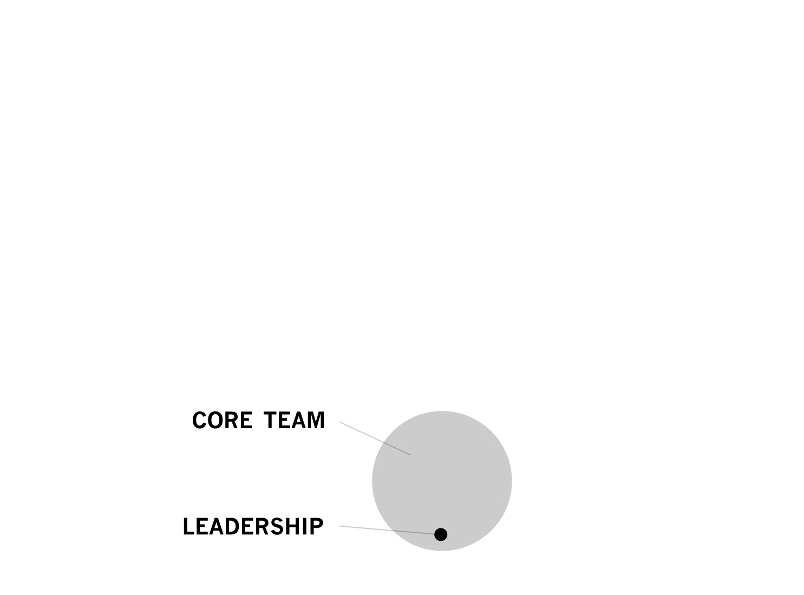
An Open Source perspective
is different: flat and functional.
Notes:
Usually, it’s more like this. It’s democratic. Small, functional.

Slide 17
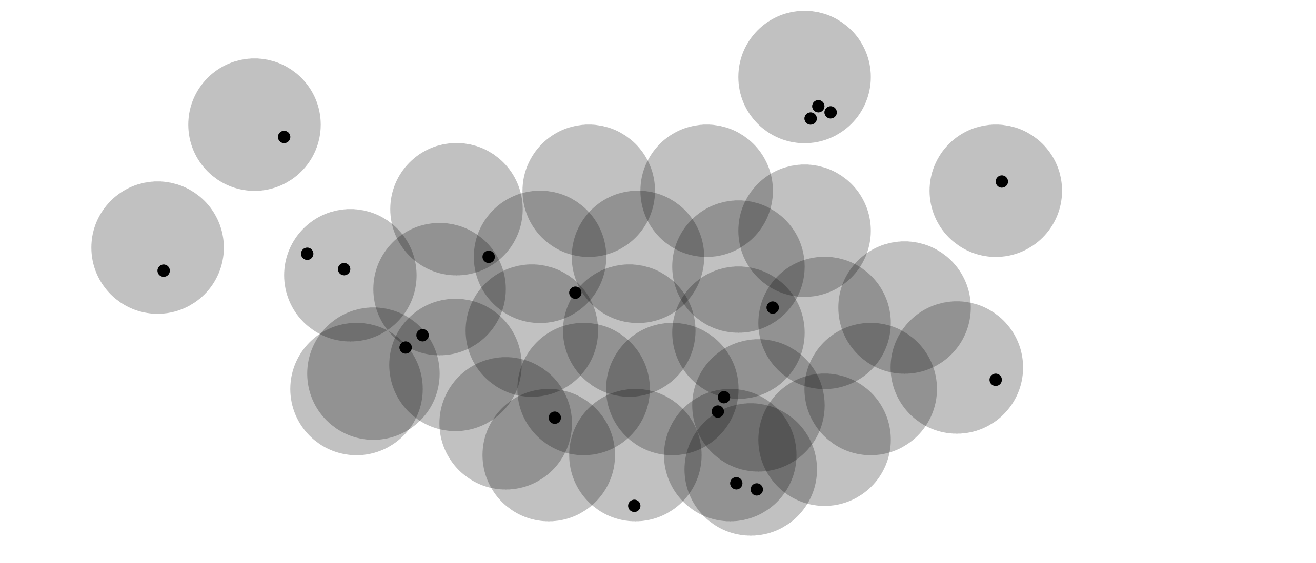
Collaboration occurs secondarily.
Notes:
During the Haiti experience, this was what I saw more of.

Slide 18
A movement can’t be “sourced.”
Notes:
How have other social movements developed? You can’t extract value as an outsider. The Civil Rights Movement led to the successful passage of the Civil Rights Act, much more powerful than the movement we have so far for humanitarian data triage. But we can understand from the example that it doesn’t make much sense to consider “sourcing” value from them – the movement is a group of peers and leaders, not just some mineral in the ground to be extracted.

Slide 19
Information is power.

Slide 20
We all can work with information to broaden our conception of our community
and actually help in a humanitarian crisis.

Slide 21
But we must design for a movement,
not a “crowd” with “workers.”

Slide 22
We can learn a lot from past success,
from past civic media.

Slide 23
“Civic media is any form of communication that strengthens the social bonds within a community or creates a strong sense of civic engagement among its residents.”
http://civic.mit.edu/
Notes:
But there was an aspect of collaboration and civic activism which was strong enough to achieve major social goals.

Slide 24
Participatory Civic Infrastructure: 1964
Paper, books, libraries, maps, postal systems, pens, pencils, phones, television, radio, church basements
Notes:
The tools that they used for networking were so basic.

Slide 25
These things won the Civil Rights Act.
Notes:
But there was an aspect of collaboration and civic activism which was strong enough to achieve major social goals.

Slide 26
The internet is not a prerequisite for massive social change.
Notes:
But there was an aspect of collaboration and civic activism which was strong enough to achieve major social goals.

Slide 27
Most of the work is not on the network
at all.
Notes:
But there was an aspect of collaboration and civic activism which was strong enough to achieve major social goals.

Slide 28
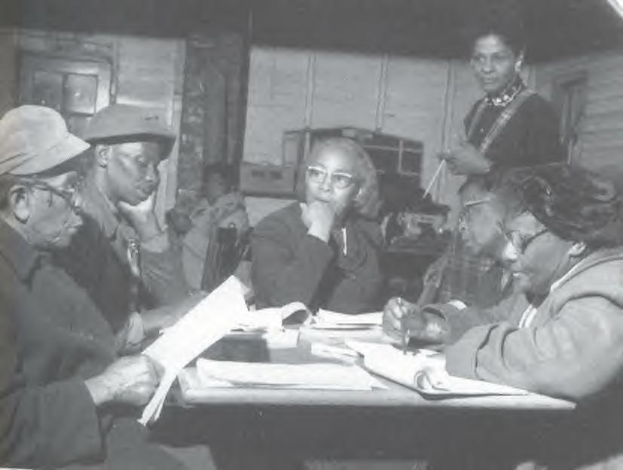
Notes:
But there was an aspect of collaboration and civic activism which was strong enough to achieve major social goals.

Slide 29
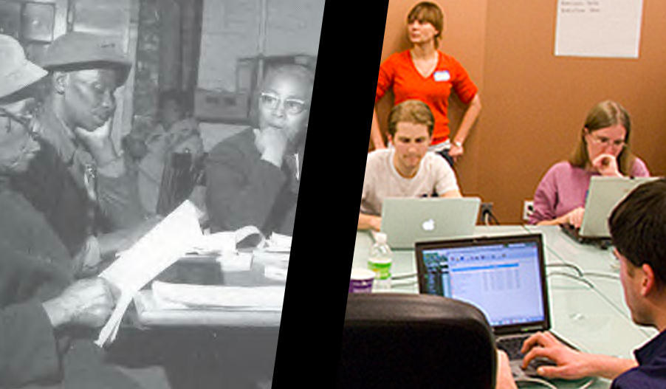
Notes:
We are doing something similar at Crisis Camps. http://www.flickr.com/photos/lesliejenkins/4283911879/ http://www.flickr.com/photos/usnationalarchives/

Slide 30
We can now catalyze a diverse team.

Slide 31
We are translators, hackers, taggers, geolocators, geeks.

Slide 32
We are rekindling something old.

Slide 33
We are grounding our work in our
own communities and crises.

Slide 34
All crises are local; we are all vulnerable.

Slide 35
But we are interconnected with a global support network, a diaspora.

Slide 36
And so we are crazy powerful.

Slide 37
Potentially.

Slide 38
Today tens of thousands of people are
participating in new forms of civic media
and crisis data triage.

Slide 39
But we need tens of millions.

Slide 40
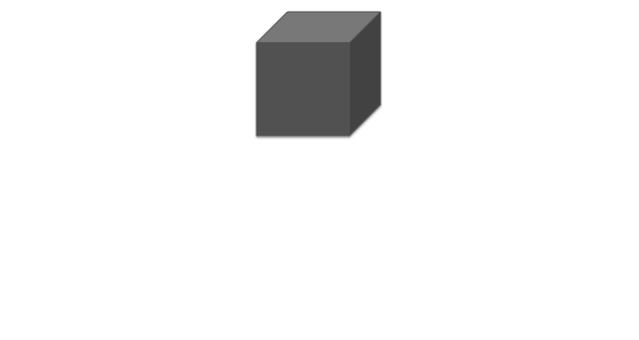
One unit of crisis data.
Notes:
So: let’s call this one unit of work.

Slide 41


Slide 43
Suddenly we have vast amounts of data about the human condition.

Slide 44
But the data is lost like wasted heat.

Slide 45
To take action, we must
turn data into knowledge.

Slide 46
Broader participation is the opportunity.

Slide 47
Education is the key to action.

Slide 48
Ultimately, we are learning
to protect each other.

Slide 49
Thanks
Illustrations and words: CC BY SA
prepared originally for ICCM 2010
by Chris Blow Meedan
Photos:
CC BY SA
http://www.flickr.com/photos/lesliejenkins/4283911879/ http://www.flickr.com/photos/usnationalarchives/

